Slide 1
TRAFFIC SIGNS
Importance of Traffic Signs:
They give timely warning of hazardous situations when they are not self relevant.
They are of great help in regulating traffic by imparting messages to drivers about the need to stop, give way and limit their speeds.
They give information about highway routes, directions and point of interest.

Slide 2
TRAFFIC SIGNS- General Principles
Traffic Signs should be installed only by the authority of law.
For imparting a sense of respect towards signs, proper enforcement measures should be undertaken.
Signs should be put up only after traffic engineering studies and sound judgement.
Excessive use of signs should not be resorted to. If used in excess, they tend to lose their effectiveness.
It should command attention from the road users. The signs should be designed for the foreseeable traffic conditions and speed on the roads on which they are proposed to be used.

Slide 3
TRAFFIC SIGNS- General Principles
6. The traffic signs should be legible and easily understood in time to produce a proper response. This means:
High Visibility both during day and night.
Lettering or symbols of adequate size for being read from far away by speeding driver without diverting the gaze through to great an angle.
Location at conspicuous position to be able to see by drivers without being obscured by vehicles and other objects
Simplicity and uniformity in design, position and application.
7. It is desirable that there should be two sizes for each type of sign namely a) standard size b) reduced size where conditions do not permit or the safety of road users does not require the erection of standard size.

Slide 4
TRAFFIC SIGNS - Requirements
It is important that these principles be given primary consideration in the selection and application of each road sign. To be effective, a road sign should meet five basic requirements:
a) Fulfill a need;
b) Command attention;
c) Convey a clear and simple meaning;
d) Command respect from road users; and
e) Give adequate time for response.

Slide 5
Types of Traffic Signs
There are several hundreds of traffic signs available covering wide variety of traffic situations. They can be classified into three main categories.
1. Regulatory/Mandatory signs: These signs require the driver to obey the signs for the safety of other road users.
2. Warning/Cautionary signs: These signs are for the safety of oneself who is driving and advice the drivers to obey these signs.
3. Informative signs: These signs provide information to the driver about the facilities available ahead, and the route and distance to reach the specific destinations

Slide 6
Regulatory/Mandatory Signs
These signs are also called mandatory signs because it is mandatory that the drivers must obey these signs.
If the driver fails to obey them, the control agency has the right to take legal action against the driver.
These signs are primarily meant for the safety of other road users.
These signs have generally black legend on a white background with red borders.
They are circular in shape with red borders.
The regulatory signs can be further classified into :
Right of way signs
Speed signs
Movement signs
Parking signs
Pedestrian Signs
Miscellaneous

Slide 7
Right of Way Signs
These include two unique signs that assign the right of way to the selected approaches of an intersection.
They are the STOP sign and GIVE WAY sign
For example, when one minor road and major road meets at an intersection, preference should be given to the vehicles passing through the major road. Hence the give way sign board will be placed on the minor road to inform the driver on the minor road that he should give way for the vehicles on the major road.
Stop sign is another example of regulatory signs that comes in right of way series which requires the driver to stop the vehicle at the stop line.

Slide 8
Speed Signs
Number of speed signs may be used to limit the speed of the vehicle on the road.
They include typical speed limit signs, truck speed, minimum speed signs etc.
Speed limit signs are placed to limit the speed of the vehicle to a particular speed for many reasons.
Separate truck speed limits are applied on high speed roadways where heavy commercial vehicles must be limited to slower speeds than passenger cars for safety reasons.
Minimum speed limits are applied on high speed roads like expressways, freeways etc. where safety is again a predominant reason.
Very slow vehicles may present hazard to themselves and other vehicles also.

Slide 9
Movement Signs
They contain a number of signs that affect specific vehicle manoeuvres.
Turn signs include turn prohibitions and lane use control signs. Lane use signs make use of arrows to specify the movements which all vehicles in the lane must take.
Turn signs are used to safely accommodate turns in un-signalized intersections.

Slide 10
Parking and Pedestrian Sign
Parking signs:
They include parking signs which indicate not only parking prohibitions or restrictions, but also indicate places where parking is permitted, the type of vehicle to be parked, duration for parking etc.
Pedestrian series:
These signs are meant for the safety of pedestrians and include signs indicating pedestrian only roads, pedestrian crossing sites etc.

Slide 11
Cautionary/Warning Signs
Cautionary/Warning signs are triangular in shape with red border and black symbol in white background.
It is used to caution and alert the road users to potential danger or existence of certain hazardous conditions either on or adjacent to the roadway so that they take the desired action.
These signs indicate a need for special caution by road users and may require a reduction in speed or some other manoeuvre.
Some examples of these signs are Hairpin Bend, Narrow Bridge, Gap in Median, School Ahead etc.

Slide 12
Informatory Signs
Informative signs also called guide signs, are provided to assist the drivers to reach their desired destinations.
These are predominantly meant for the drivers who are unfamiliar to the place.
All Informatory signs and Guiding signs for facilities are rectangular in shape.
Some of the examples for these type of signs are route markers, destination signs, mile posts, service information, recreational and cultural interest area etc.
Informatory Signs for facilities indicates location and direction to facilities like "fuel station" or "eating place" or "parking" and shall be a symbol within a rectangular board with blue background.

Slide 13
Informatory Signs
Destination signs are used to indicate the direction to the critical destination points, and to mark important intersections.
They are, in general, rectangular with the long dimension in the horizontal direction. They are colour coded as white letters with green background.

Slide 14


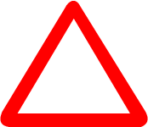

Red circle instructs what should not be done.
Blue circle instructs what should be done.
Triangle cautions
Blue rectangle informs

Slide 15
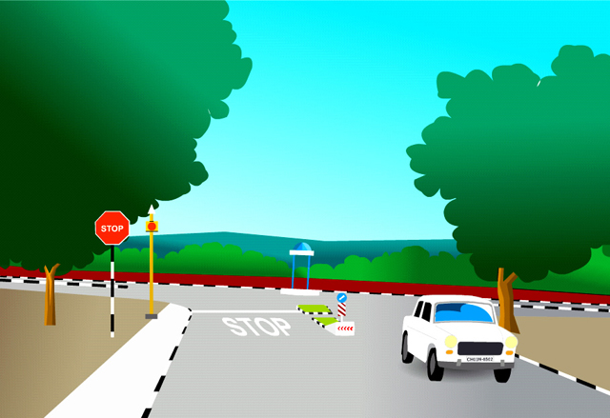


Slide 16
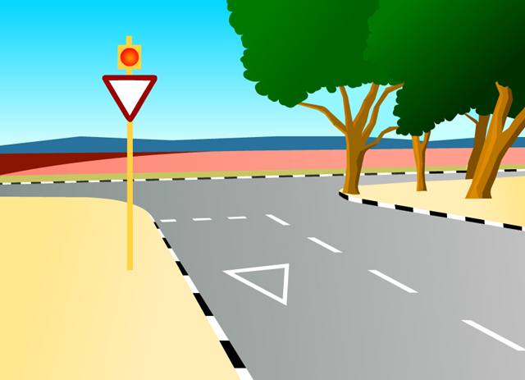


Slide 17
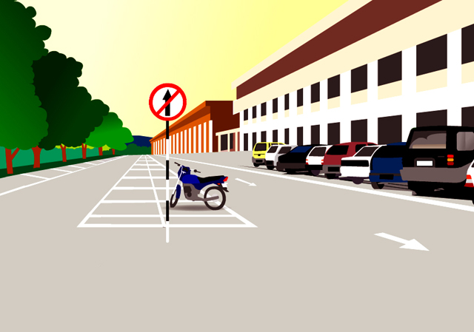

Straight Prohibited/No entry

Slide 18
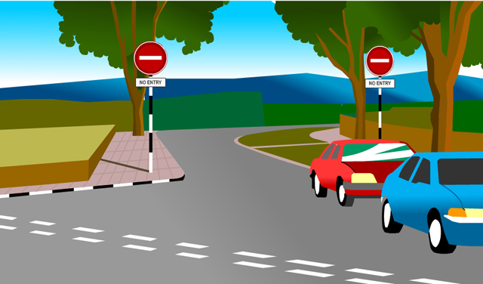

No Entry
Certain pockets of an area or road are demarcated as no entry areas for traffic. This could be entry to a restricted area or no traffic zone. So the driver should obey it and divert his route.

Slide 19

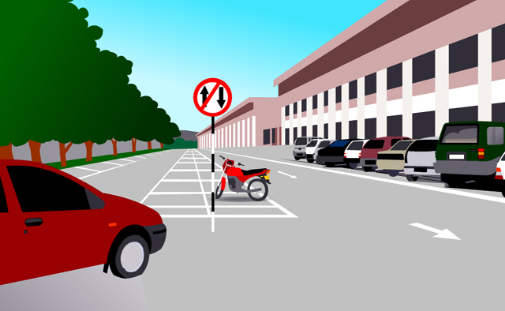

One way sign

Slide 20
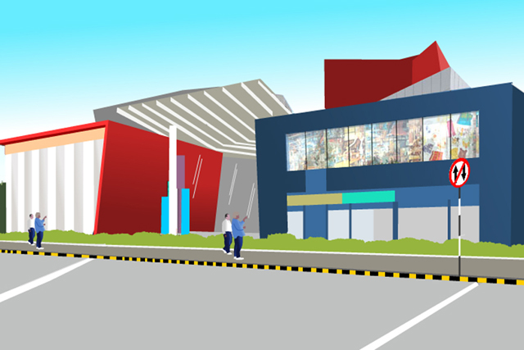

Vehicles prohibited in both directions
This sign directs that the demarcated area beyond it is prohibited for traffic flow from both sides. There could be number of reasons for installing this sign such as pedestrian area only, area under repair, security reasons etc.

Slide 21
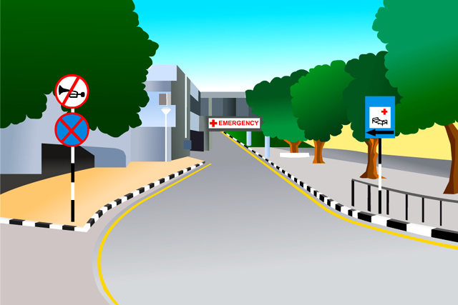

Horn Prohibited

Slide 22
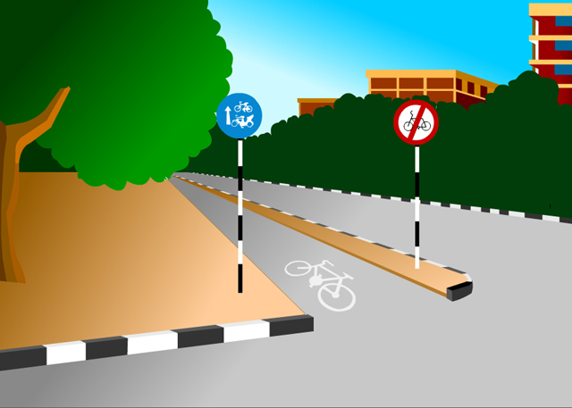
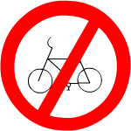
Cycles Prohibited

Slide 23
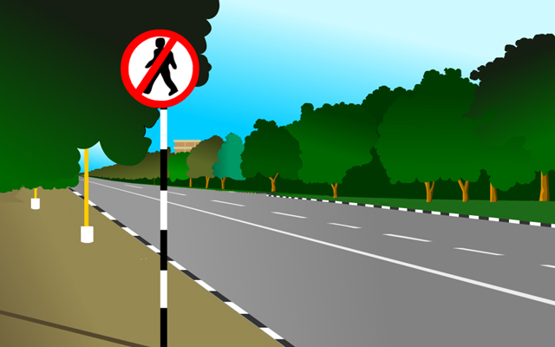
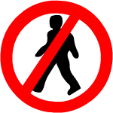
Pedestrian Prohibited

Slide 24

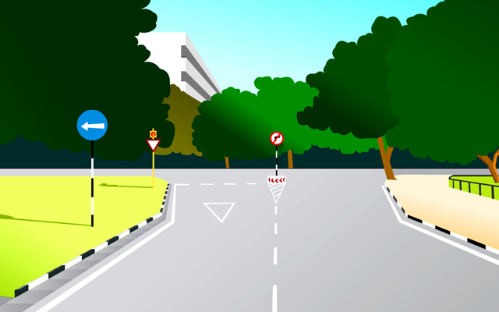
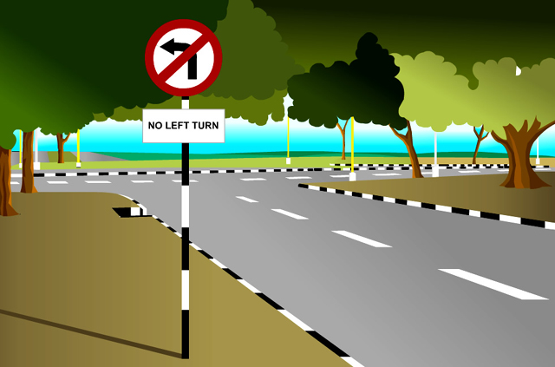

Right/left turn prohibited
These signs are used at places where vehicles are not allowed to make a turn to the right or left. The signs are also used at the inter-sections of one-way street to supplement the one-way sign.

Slide 25
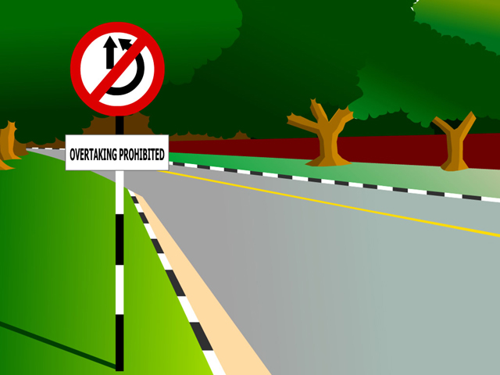

Overtaking Prohibited
This sign is erected at the beginning of such sections of highways where sight distance is restricted and overtaking will be dangerous.

Slide 26
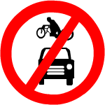
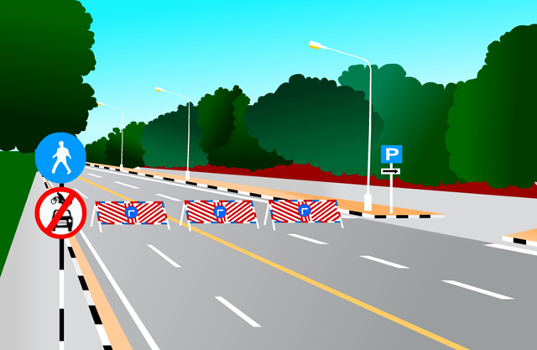
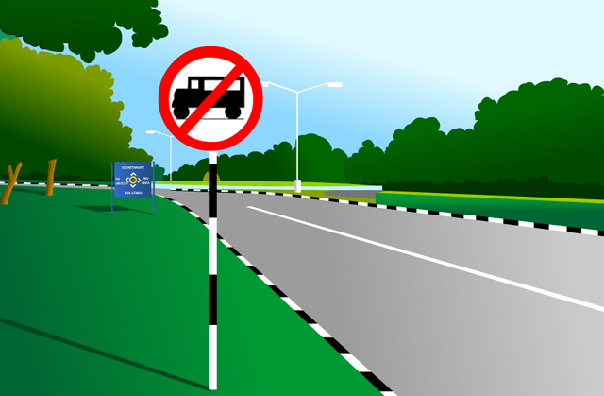

All motor vehicles prohibited
Trucks Prohibited

Slide 27
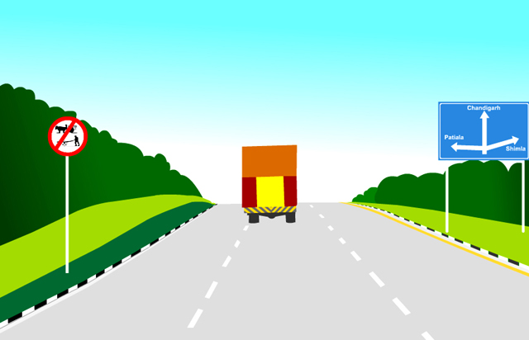

This sign is erected on each entry to the road where all types of slow moving vehicles except cycles are to be prohibited.

Slide 28
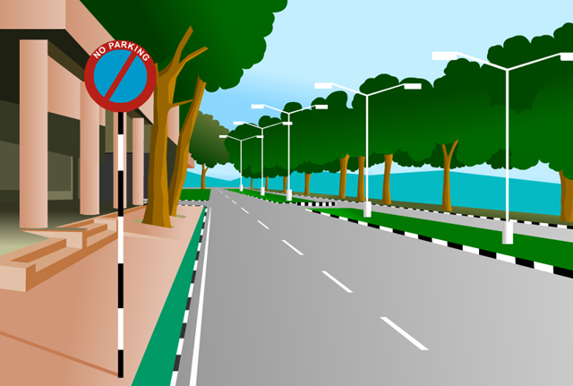

NO PARKING: This sign is erected where parking is not allowed but vehicles can stop for short duration to allow passengers to get into or get out of the vehicle. The sign should be accompanied by suitable kerb or carriageway markings.

Slide 29
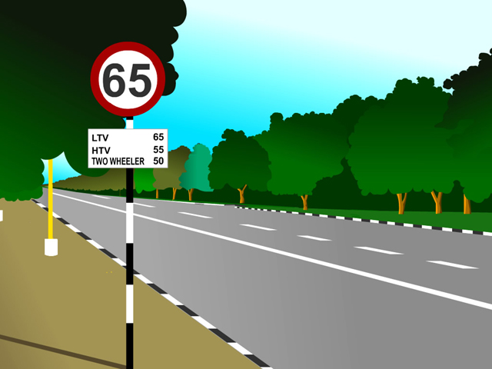
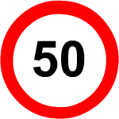

Slide 30
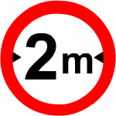
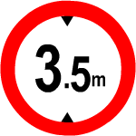
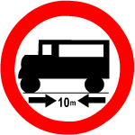
WIDTH LIMIT: This sign is used where entry of vehicles exceeding a particular width is prohibited.
HEIGHT LIMIT: This sign is erected in advance of an overhead structure where entry is prohibited for vehicles whose height exceeds a certain limit.
LENGTH LIMIT: This sign is used where entry of vehicles exceeding a particular length is prohibited.

Slide 31
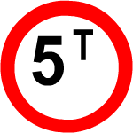
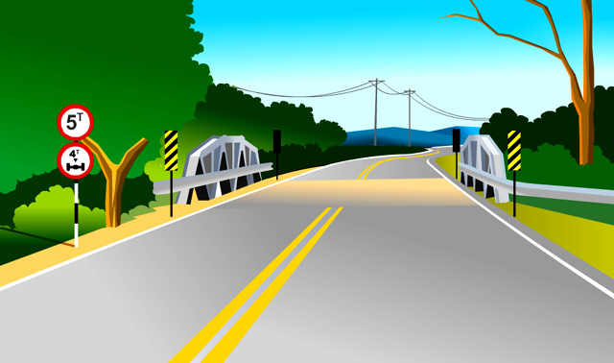
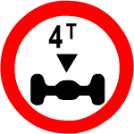
LOAD LIMIT: This sign is used where entry of vehicles is prohibited for vehicles whose laden weight exceeds a certain limits.
AXLE LOAD LIMIT: This sign is used where entry of vehicles is prohibited for vehicles whose axle load exceeds a certain limits.

Slide 32
Similarly Learn the rest of the Signs and Road Markings

Slide 33
CONFLICT POINTS
Conflicts usually arises at intersections, especially at uncontrolled intersections
When two
The different types of conflicts at uncontrolled intersections are:
Crossing Conflicts
Merging Conflicts
Diverging Conflicts

Slide 34
CONFLICT POINTS
Crossing conflict is a major conflict and occurs at intersection – at grade. Unless one vehicle senses an error and stops or slows down a major conflict is unavoidable.
Merging and diverging conflicts are minor conflicts as the merging or diverging angles and speeds of the pair of vehicles are relatively low.

Slide 35
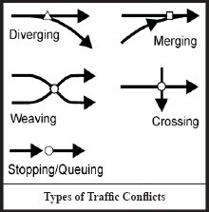

Slide 36
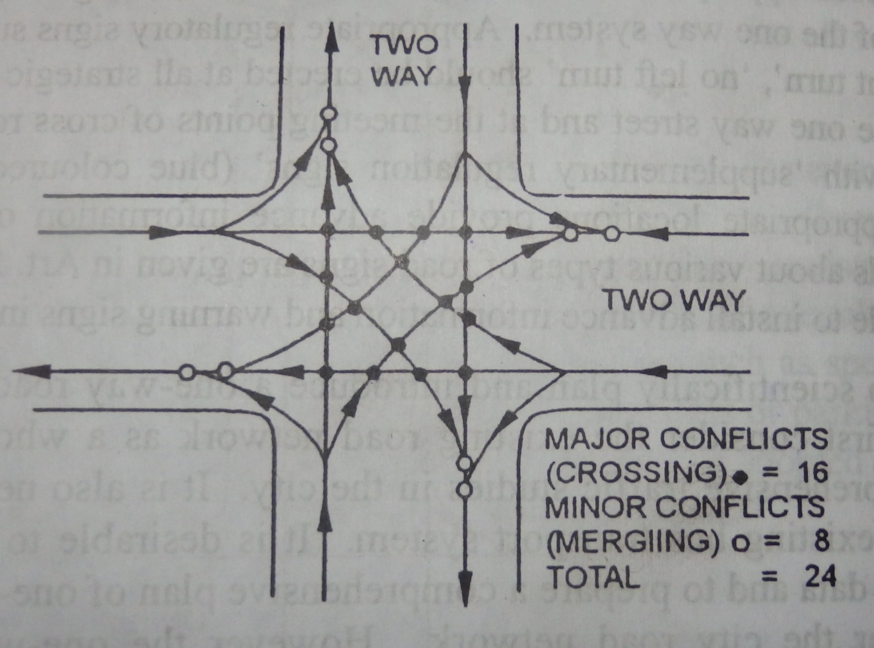
Conflict points in an intersection having two way traffic
Major Conflicts: 16(crossing)
Minor Conflicts: 8(merging)
Total: 24 conflicts.
Source: Highway Engineering by Khanna & Justo.

Slide 37
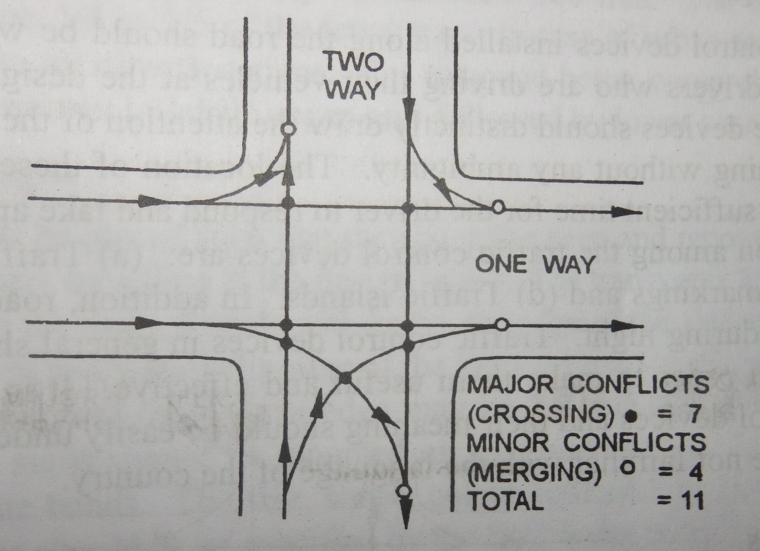
Conflict Points
If one of the two cross roads in the above case discussed is declared a one way. What would be the decrease in conflict points?
Major Conflicts: 7(crossing)
Minor Conflicts: 4(merging)
Total: 11 conflicts.

Slide 38
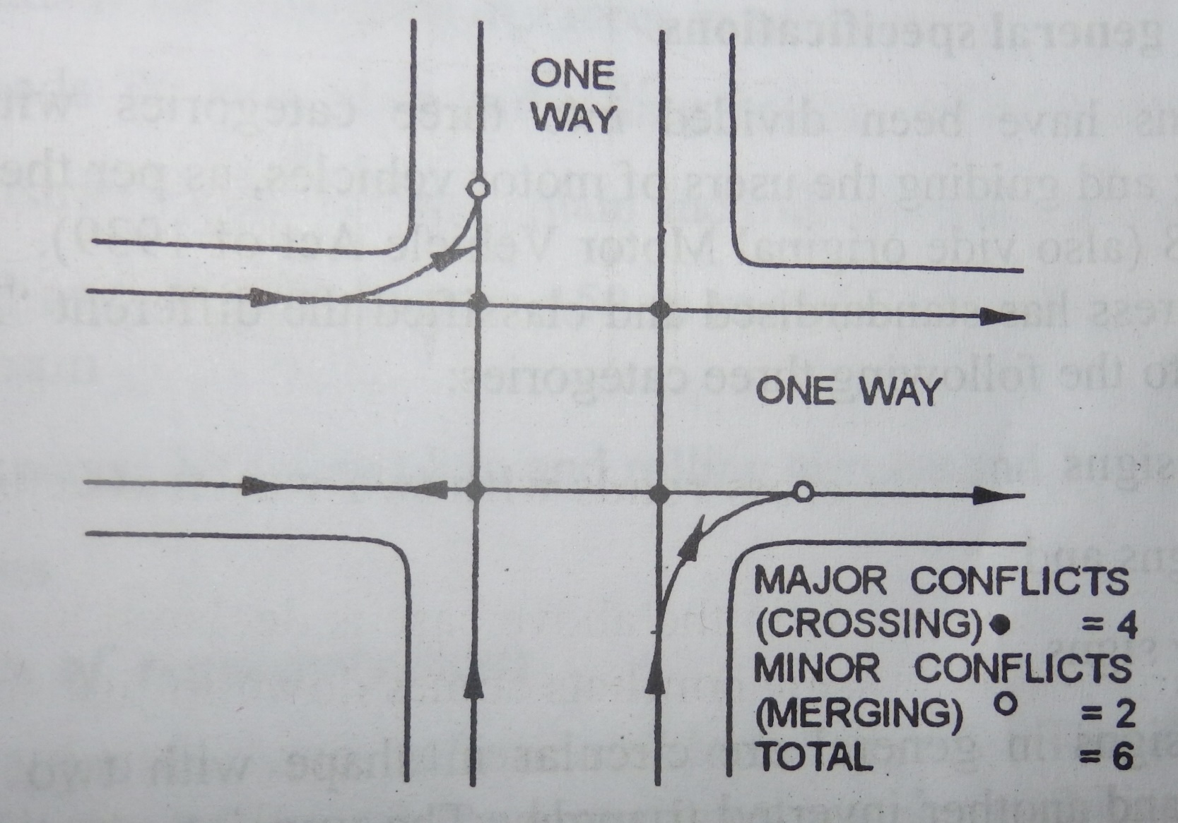
Conflict Points
Assume if both the two lane cross roads are declared as a one way. What would be the total conflict points?
Major Conflicts: 4(crossing)
Minor Conflicts: 2(merging)
Total: 6 conflicts.

Slide 39
Reduction in Potential Conflict Points on cross roads of different lane widths due to imposing one-way regulation
No of Lanes |  | No of Potential Conflict Points
Road A | Road B | Both Roads Two-Way | A – One Way B – Two Way | Both Roads One Way
2 | 2 | 24 | 11 | 6
2 | 4 | 32 | 17 | 10
4 | 4 | 44 | 25 | 18

Slide 40
Conflict points
You have determined conflict points for the vehicles only.
Now take pedestrians on the road and determine the conflict points for all the three cases discussed above (home work).
From this understanding of the conflict points you have an idea how much a one way road is able to reduce accidents apart form the fact that it reduces the traffic congestion and increases the average speeds.

Slide 41
One Way Streets
In congested streets one of the method to reduce severe vehicle accidents and to ensure smooth vehicle movement is by regulating traffic along one-way streets.
It means that the traffic is allowed to move in only one specified direction.
But these regulations are possible only if there is a network of roads connecting two bigger roads or
The additional distance traversed by some vehicles is not excessive.
As a general guideline the IRC suggests due to one way street the additional distance traversed should not exceed 30% of the original distance.

Slide 42
One Way Streets
Installation of appropriate traffic signs and lane markings are essential before the introduction of one way system.
Regulatory signs like ‘no entry’, ‘one-way’, ‘no right turn’, ‘no left turn’, should be erected at all strategic locations especially near the approach and ends of the one way street and meeting points of the cross roads.
In order to scientifically plan and introduce a one way street the whole road network of that area/city needs to be thoroughly studied by performing comprehensive traffic studies in the city or else it would lead to some other problems else where.

Slide 43
One way streets
Advantages:
Increase in average travel speeds
More effective coordination of signal system
Slight increase in roadway capacity
More streamlined movement of vehicles
Reduction in conflict points/accidents
Improved pedestrian movement

